Slide 1

Big Data and Data Science

Slide 2
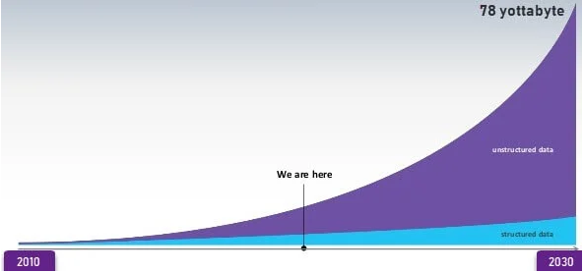
Introduction
Data that is always increasing and cannot be processed and stored on a single machine is termed as Big Data.

Slide 3
Big Data
Big data refers to extremely large and diverse collections of structured, unstructured, and semi-structured data that continues to grow exponentially over time.
These datasets are so huge and complex in volume, velocity, and variety, that traditional data management systems cannot store, process, and analyze them.
The amount and availability of data is growing rapidly, spurred on by digital technology advancements, such as connectivity, mobility, the Internet of Things (IoT), and artificial intelligence (AI). As data continues to expand and proliferate, new big data tools are emerging to help companies collect, process, and analyze data at the speed needed to gain the most value from it.
Big data describes large and diverse datasets that are huge in volume and also rapidly grow in size over time. Big data is used in machine learning, predictive modeling, and other advanced analytics to solve business problems and make informed decisions.

Slide 4
Motivation
Big Data has given the organization a new way to analyze and visualize their data effectively.
For example:
Business: Customer Feedback, trends etc.
Health: Health care organizations are leveraging big data technology to capture all the information about a patient to get more complete view for insight into care coordination, health management & outcome.

Slide 5
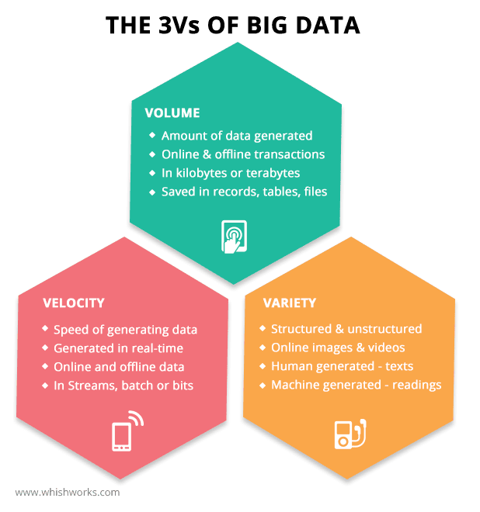

Slide 6
How Big Data Work
Making big data work requires three main actions:
Integration: Big data collects terabytes, and sometimes even petabytes, of raw data from many sources that must be received, processed, and transformed into the format that business users and analysts need to start analyzing it.
Management: Big data needs big storage, whether in the cloud, on-premises, or both. Data must also be stored in whatever form required. It also needs to be processed and made available in real time. Increasingly, companies are turning to cloud solutions to take advantage of the unlimited compute and scalability.
Analysis: The final step is analyzing and acting on big data—otherwise, the investment won’t be worth it. Beyond exploring the data itself, it’s also critical to communicate and share insights across the business in a way that everyone can understand. This includes using tools to create data visualizations like charts, graphs, and dashboards.

Slide 7
Applications
Tracking Customer Spending Habit, Shopping Behavior: In big retails store (like Amazon, Walmart, Big Bazar etc.) management team has to keep data of customer’s spending habit shopping behavior, customer’s most liked product (so that they can keep those products in the store).
Recommendation: By tracking customer spending habit, shopping behavior, Big retails store provide a recommendation to the customer. E-commerce site like Amazon, Walmart, Flipkart does product recommendation.
Education Sector: Online educational course conducting organization utilize big data to search candidate, interested in that course. If someone searches for YouTube tutorial video on a subject, then online or offline course provider organization on that subject send ad online to that person about their course.

Slide 8
Examples
Tracking consumer behavior and shopping habits to deliver hyper-personalized retail product recommendations tailored to individual customers
Monitoring payment patterns and analyzing them against historical customer activity to detect fraud in real time
Combining data and information from every stage of an order’s shipment journey with hyperlocal traffic insights to help fleet operators optimize last-mile delivery
Using AI-powered technologies like natural language processing to analyze unstructured medical data (such as research reports, clinical notes, and lab results) to gain new insights for improved treatment development and enhanced patient car
Using image data from cameras and sensors, as well as GPS data, to detect potholes and improve road maintenance in cities
Analyzing public datasets of satellite imagery and geospatial datasets to visualize, monitor, measure, and predict the social and environmental impacts of supply chain operations

Slide 9
Challenges
Lack of knowledge Professionals
Lack of proper understanding of Massive Data
Data Growth Issues
Integrating Data from a Spread of Sources
Securing Data

Slide 10
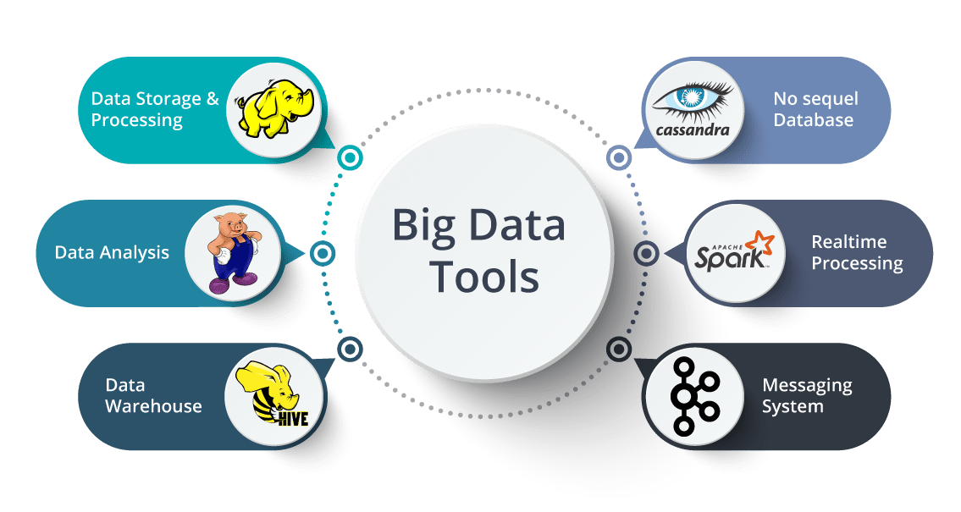
Tools and techniques

Slide 11
Data Science
Data science is a field that deals with unstructured, structured data, and semi-structured data. It involves practices like data cleansing, data preparation, data analysis, and much more.
Data science is the combination of: statistics, mathematics, programming, and problem-solving;, capturing data in ingenious ways; the ability to look at things differently; and the activity of cleansing, preparing, and aligning data. This umbrella term includes various techniques that are used when extracting insights and information from data.
Unlock the potential of analytics with Simplilearn's top-rated analytics courses. Gain a competitive edge in the job market and propel your career forward.

Slide 12
Need of Data Science
From business to the health industry, science to our everyday lives, marketing to research, in fact, for everything in a fraternity, data is required to thrust the movement forward. Computer science and information technology have taken over our lives, and it is advancing with each passing day with such velocity and variety that the operational techniques used a few years back have now become obsolete.
The same is the case with challenges and problems. The problems and concerns of the past for a specific theme, illness, or shortfall may not be the same today as they have advanced in terms of complexity.
Every field of science and study or organization, therefore, needs an updated set of operational systems and technology to keep up with the challenges of today and tomorrow as well as to derive solutions for unanswered questions

Slide 13
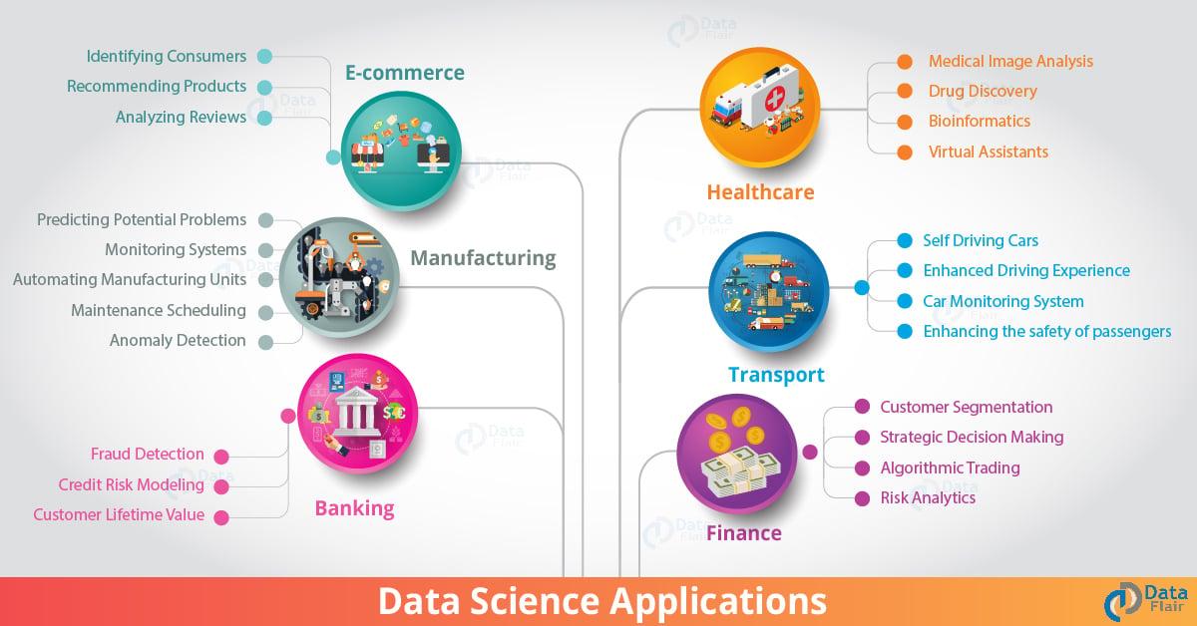

Slide 14
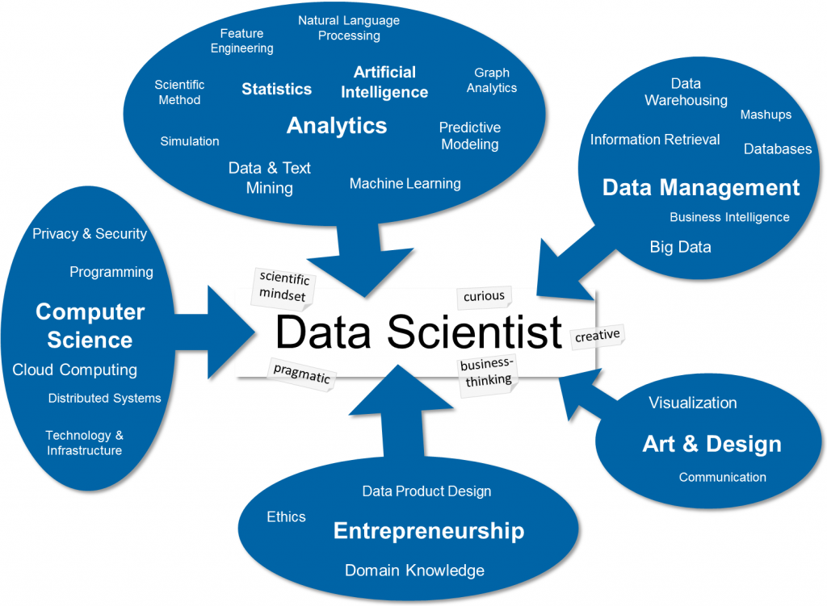

Slide 15
Employ and utilize
Organizations can use big data analytics systems and software to make data-driven decisions that can improve business-related outcomes.
The benefits may include more effective marketing, new revenue opportunities, customer personalization and improved operational efficiency.
With an effective strategy, these benefits can provide competitive advantages over rivals.

Slide 16
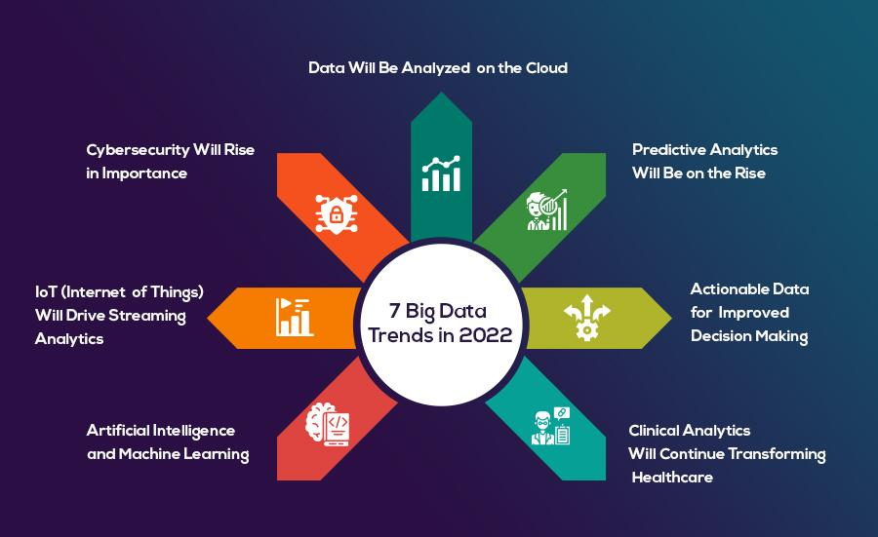
Current trends and opportunities

Slide 17
Apache Hadoop
Apache Hadoop is an open source, Java-based software platform that manages data processing and storage for big data applications.
The platform works by distributing Hadoop big data and analytics jobs across nodes in a computing cluster, breaking them down into smaller workloads that can be run in parallel. Some key benefits of Hadoop are scalability, resilience and flexibility.
The Hadoop Distributed File System (HDFS) provides reliability and resiliency by replicating any node of the cluster to the other nodes of the cluster to protect against hardware or software failures.
Hadoop flexibility allows the storage of any data format including structured and unstructured data.

Slide 18
Tableau
Tableau is a powerful tool used for data analysis and visualization. It allows the creation of amazing and interactive visualization and that too without coding.
Tableau is very famous as it can take in data and produce the required data visualization output in a very short time.
Basically, it can elevate your data into insights that can be used to drive your action in the future..

Slide 19
Tableau Features
Tableau supports powerful data discovery and exploration that enables users to answer important questions in seconds
No prior programming knowledge is needed; users without relevant experience can start immediately with creating visualizations using Tableau
It can connect to several data sources that other BI tools do not support. Tableau enables users to create reports by joining and blending different datasets
Tableau Server supports a centralized location to manage all published data sources within an organization

Slide 20
R language
R is a language and environment for statistical computing and graphics. It is a GNU project which is similar to the S language and environment which was developed at Bell Laboratories (formerly AT&T, now Lucent Technologies) by John Chambers and colleagues. R can be considered as a different implementation of S.
There are some important differences, but much code written for S runs unaltered under R.
R provides a wide variety of statistical (linear and nonlinear modelling, classical statistical tests, time-series analysis, classification, clustering, …) and graphical techniques, and is highly extensible. The S language is often the vehicle of choice for research in statistical methodology, and R provides an Open Source route to participation in that activity.
One of R’s strengths is the ease with which well-designed publication-quality plots can be produced, including mathematical symbols and formulae where needed. Great care has been taken over the defaults for the minor design choices in graphics, but the user retains full control.
R is available as Free Software under the terms of the Free Software Foundation’s GNU General Public License in source code form. It compiles and runs on a wide variety of UNIX platforms and similar systems (including FreeBSD and Linux), Windows and MacOS.

Slide 21
Big Data and Cloud
Cloud Computing providers often utilize a “software as a service” model to allow customers to easily process data. Typically, a console that can take in specialized commands and parameters is available, but everything can also be done from the site’s user interface. Some products that are usually part of this package include database management systems, cloud-based virtual machines and containers, identity management systems, machine learning capabilities, and more.
In turn, Big Data is often generated by large, network-based systems. It can be in either a standard or non-standard format. If the data is in a non-standard format, artificial intelligence from the Cloud Computing provider may be used in addition to machine learning to standardize the data.
From there, the data can be harnessed through the Cloud Computing platform and utilized in a variety of ways. For example, it can be searched, edited, and used for future insights.
This cloud infrastructure allows for real-time processing of Big Data. It can take huge “blasts” of data from intensive systems and interpret it in real-time.
Another common relationship between Big Data and Cloud Computing is that the power of the cloud allows Big Data analytics to occur in a fraction of the time it used to.

Slide 22
Job roles
Business Analyst
Data Analyst
Data Scientist
Data Engineer/Data Architect
Machine Learning Engineer
Big Data Engineer

Slide 23
Skill Set
Analytical Skills
Data Visualization Skills
Problem Solving Skills
SQL – Structured Query Language
Skills of Programming - Python, Java, R

